Slide 1
Robotic Process Automation Research
Junxiong(Frank) Gao
21.5.2019

Slide 2
Research Agenda
E2E structure
What & How
Mining Condition Model(CM)
(A kind of behavior pattern)
Mining with Case id
Mining without Case id
Complex Rule
What is Complex Rule(CR)
Learning Condition Function of CR (CM+ Causality)
Learning Response Function of CR (CM+ Data Mining)
Operating Problems
RE, multiply Rules’ conditions satisfied, select which one?
Detect Interface change and update Rules

Slide 3
Research Agenda
Today Topic
E2E structure
What & How
Mining Condition Model(CM)
(A kind of behavior pattern)
Mining with Case id
Mining without Case id
Complex Rule
What is Complex Rule(CR)
Learning Condition Function of CR (CM+ Causality)
Learning Response Function of CR (CM+ Data Mining)
Operating Problems
RE, multiply Rules’ conditions satisfied, select which one?
Detect Interface change and update Rules

Slide 4
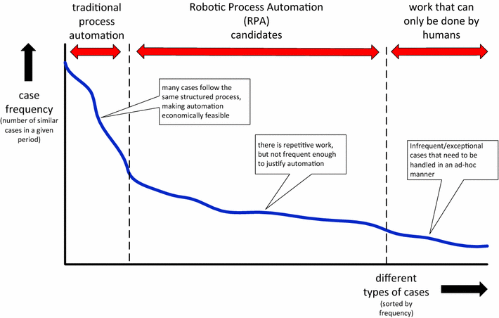
Positioning of candidate processes for RPA
Goal of RPA:
No change in Backend system
Automation in Frontend by Robot

Slide 5



Current RPA products
Two problems
Require domain knowledge, people need to know “What” and “How” to automate
Heavily Labor Intensive, model every detail for robot
Do what I said

Slide 6
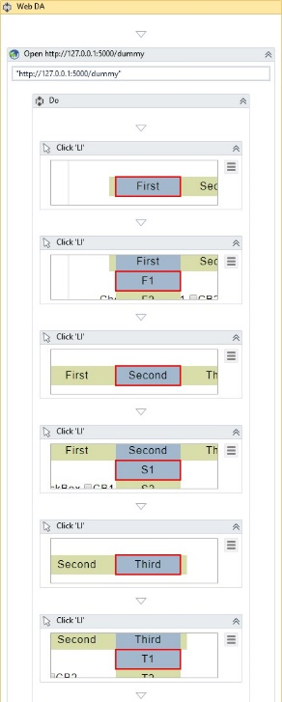
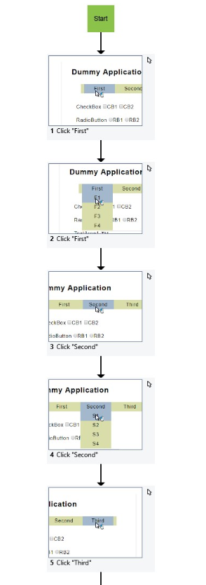
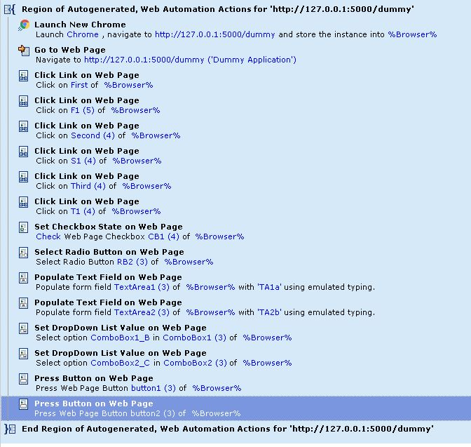
Current RPA product
Uipath
Kryon
WinAutomation

Slide 7

Desired RPA
Automatically deduce robot behavior rules
Standardized by form action, IO-Log
1
I know what are you doing
Observing
2
Hmmm~ You do things basing on some Rules
Learning Rules from IO-Log
3
Helping
Generating Response
I could do this thing for you

Slide 8
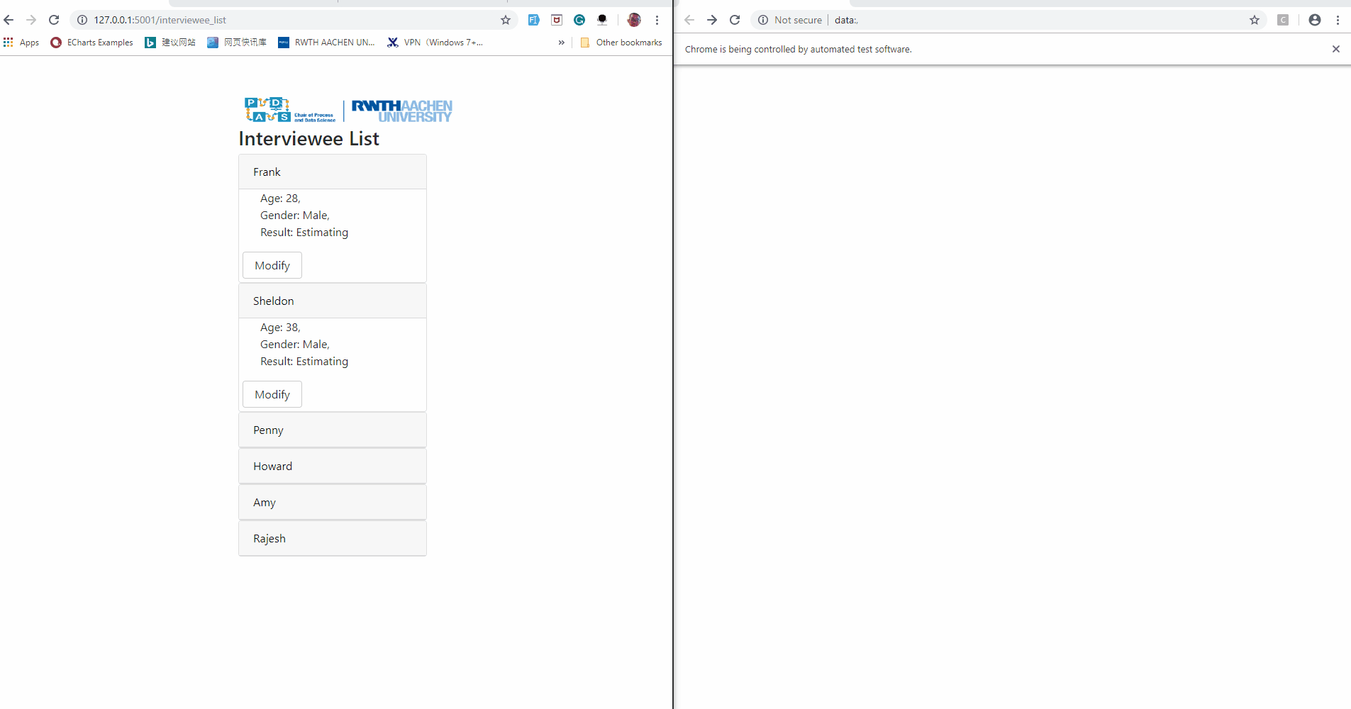
Desired RPA
Human
Robot

Slide 9
E2E Structure
Users
Interaction
Systems
Other Interaction
Abstract the Reality by Form and Form Action
Human
Form
Form Action
Form
Robot
Form
Operating
Form Action
Form
Collect FA
Verify
Rules
Learn
IO-Log
Training

Slide 10
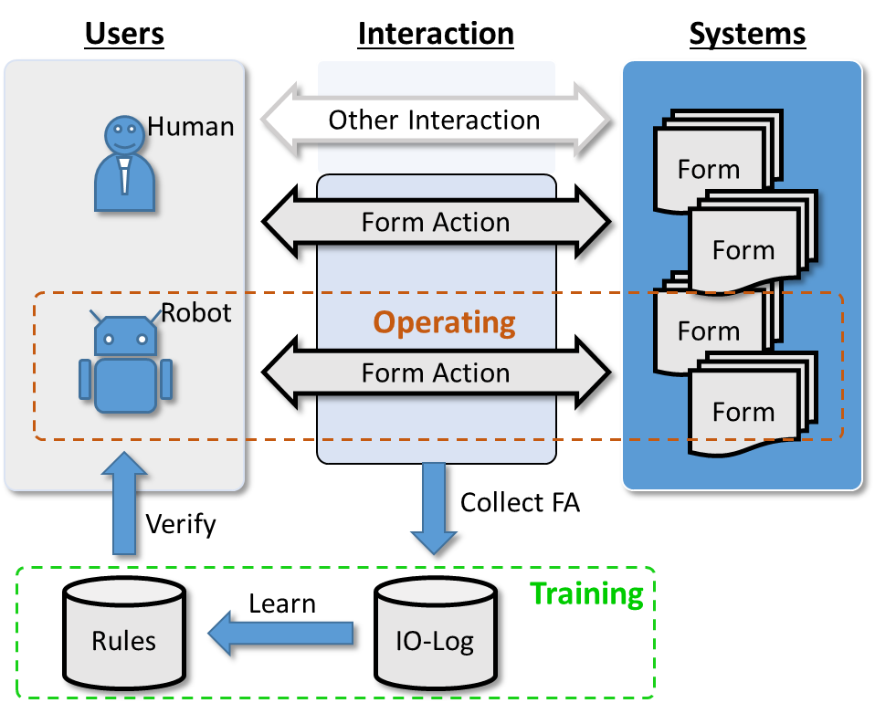
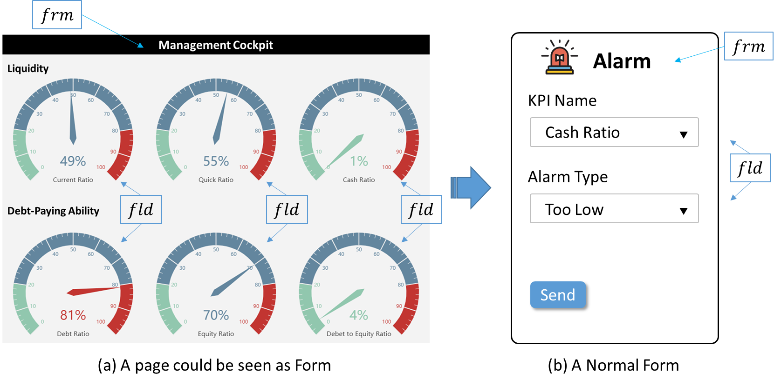
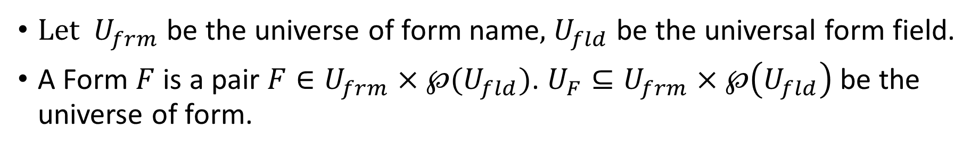
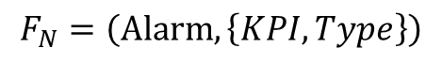
Form
Let $U_{frm}$ be the universe of form name, $U_{fld}$ be the universal form field.
A Form $F$ is a pair $F∈U_{frm}×℘(U_{fld})$. $U_{F}⊆U_{frm}×℘\left(U_{fld}\right)$ be the universe of form.
$$F_{MC}=(MC,\{CR,QR,CashR,DR,ER,DER\})$$
$$F_{N}=\left(Alarm,\left\{KPI,Type\right\}\right)$$
Any type of information container could seen as a form,
as long as it has constant structure and position in system.

Slide 11
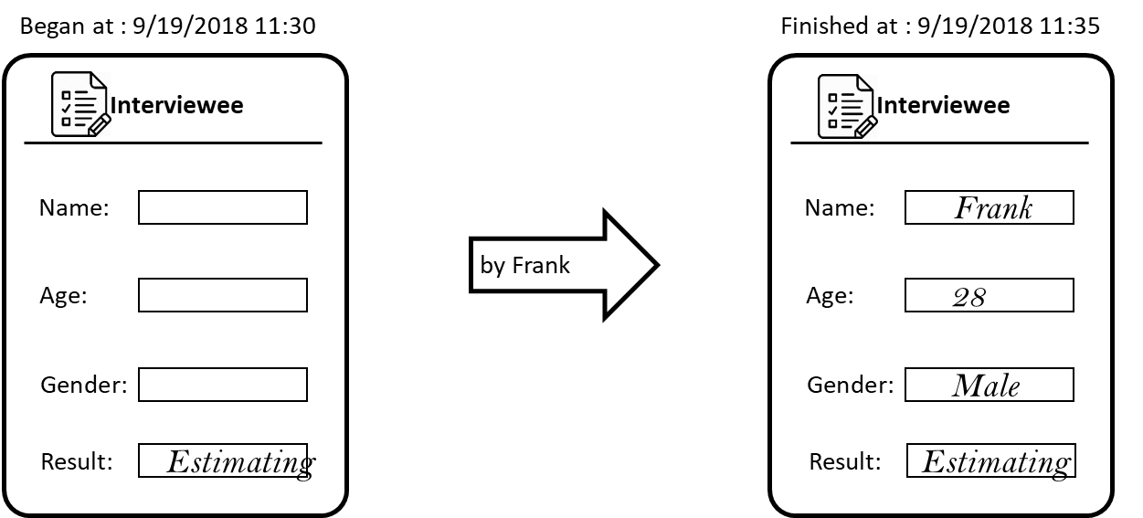
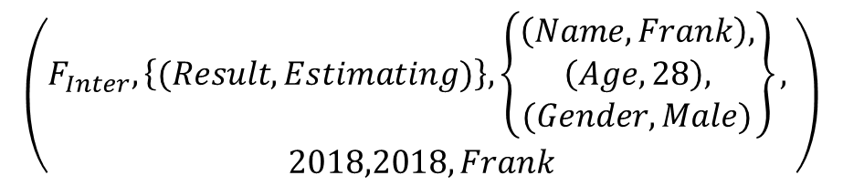
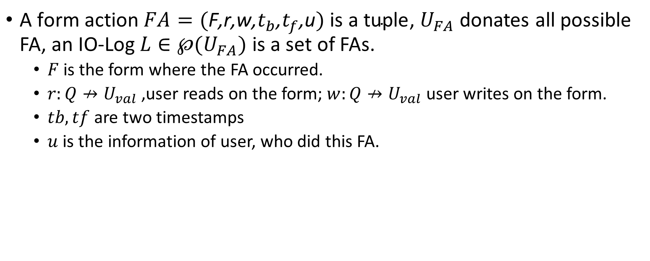
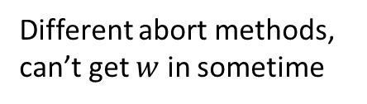
Form Action
$\text{A} \text{form} \text{action} FA=(\text{F}\text{,}\text{r}\text{,}\text{w}\text{,}t_{b}\text{,}t_{f}\text{,}\text{u}) \text{is} \text{a} \text{tuple}$, $U_{FA}$ donates all possible FA, an IO-Log $L∈℘(U_{FA})$ is a set of FAs.
$F$is the form where the FA occurred.
$r:Q↛U_{val}$ ,user reads on the form; $w:Q↛U_{val}$ user writes on the form.
$tb,tf$ are two timestamps
$u$ is the information of user, who did this FA.
$$\left(\begin{aligned}F_{Inter},\left\{(Result,Estimating)\right\},\left\{\begin{aligned}\left(Name,Frank\right), \\ \left(Age,28\right), \\ (Gender,Male)\end{aligned}\right\}, \\ 2018,2018,Frank\end{aligned}\right)$$
Different abort methods, can’t get $w$ in sometime

Slide 12
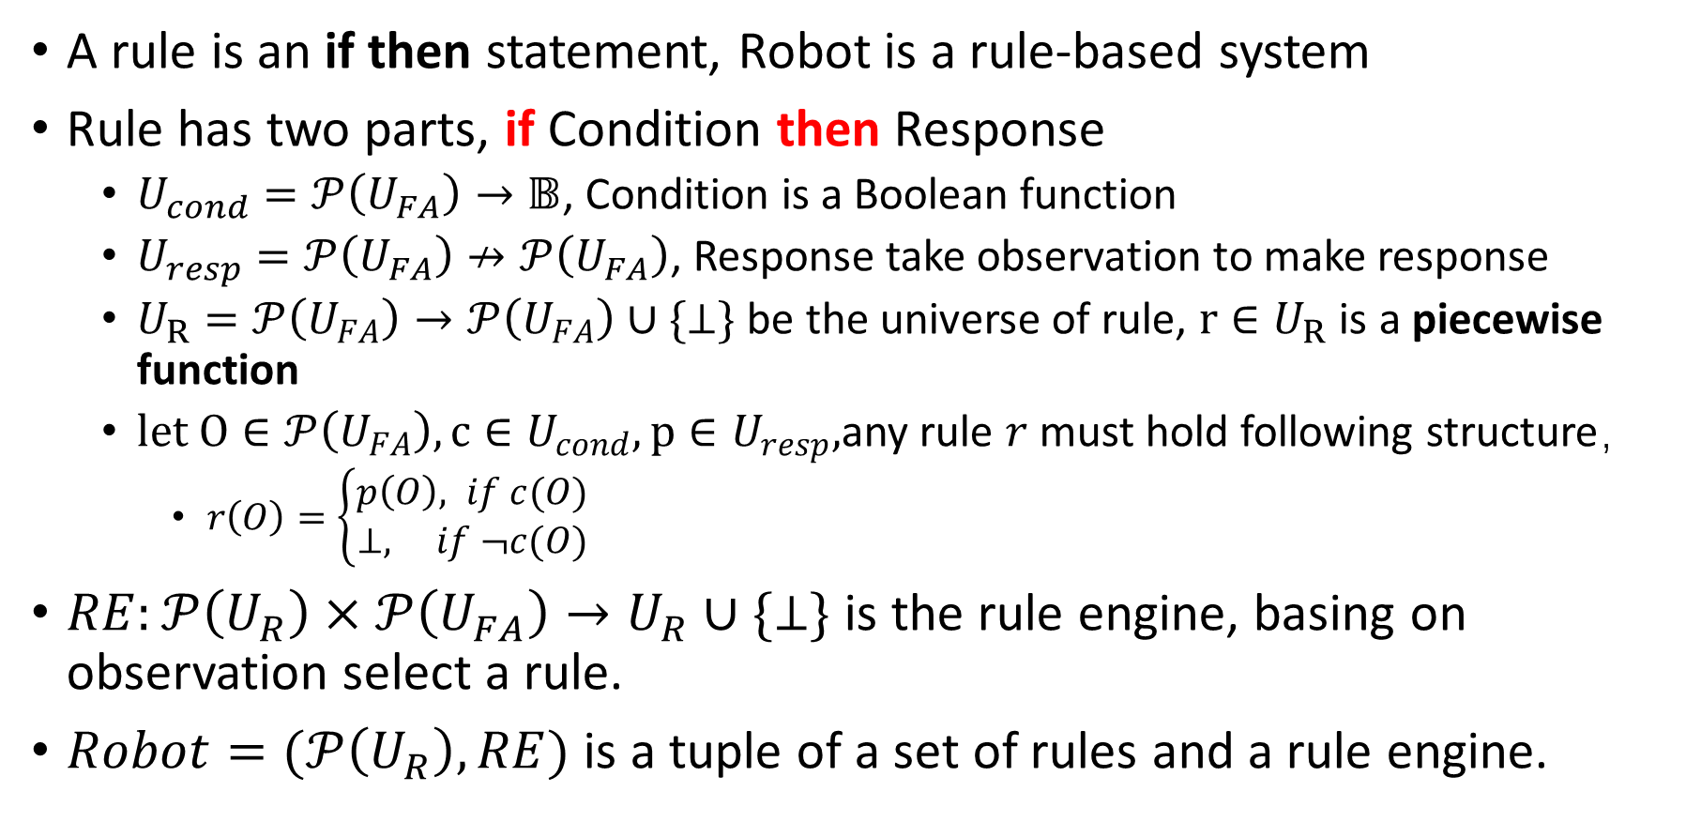
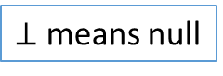
Rule, Robot
A rule is an if then statement, Robot is a rule-based system
Rule has two parts, if Condition then Response
$U_{cond}=𝒫\left(U_{FA}\right)→𝔹$, Condition is a Boolean function
$U_{resp}=𝒫\left(U_{FA}\right)↛𝒫\left(U_{FA}\right)$, Response take observation to make response
$U_{R}=𝒫\left(U_{FA}\right)→𝒫\left(U_{FA}\right)∪\{⊥\}$ be the universe of rule, $r∈U_{R}$ is a piecewise function
$let O∈𝒫\left(U_{FA}\right), c∈U_{cond}, p∈U_{resp},$any rule $r$ must hold following structure，
$r\left(O\right)=\left\{\begin{aligned}p\left(O\right), if c(O) \\ &⊥, if ¬c(O)\end{aligned}\right.$
$RE:𝒫\left(U_{R}\right)×𝒫\left(U_{FA}\right)→U_{R}∪\{⊥\}$ is the rule engine, basing on observation select a rule.
$Robot=(𝒫\left(U_{R}\right),RE)$ is a tuple of a set of rules and a rule engine.
$⊥$ means null

Slide 13
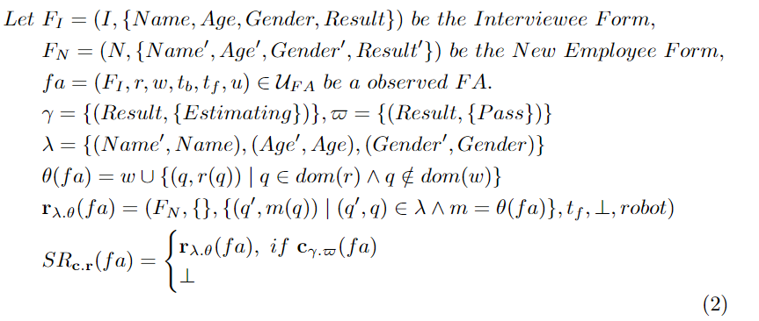
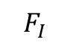
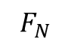
Rule
Simple Rule
Definition
Observe one FA response one FA, only detect the copy between them
A lot formalization……
Example
$$F_{I}$$
$$F_{N}$$

Slide 14
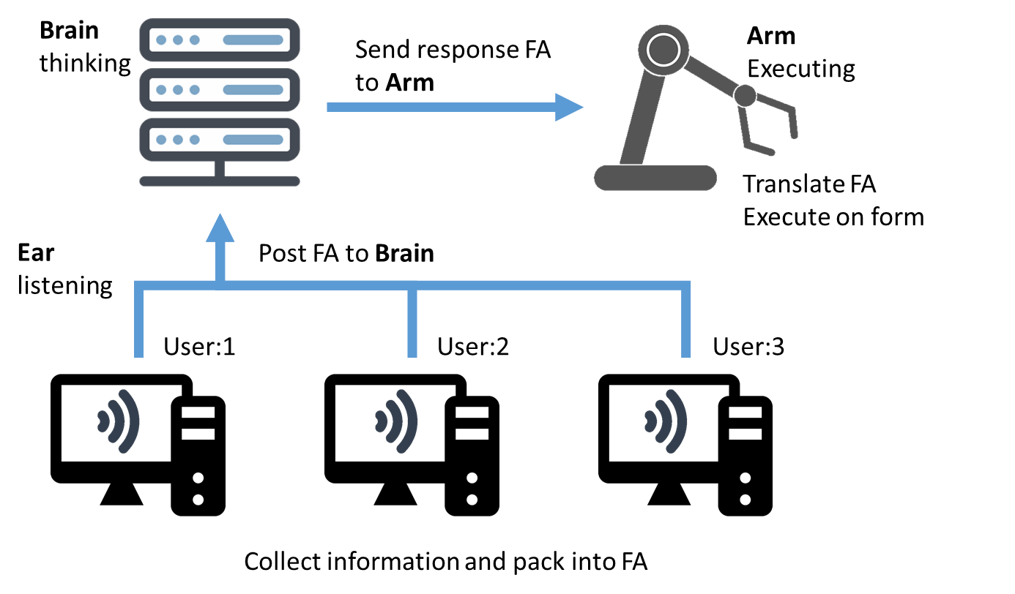
Implementation-Robot Structure

Slide 15


Operating-Collect IO-Log
Operating
When
Ear
Brain
1. Send Address
Enter in Page
2. Test Address
4. Collect form field value for read, basing on setting
3.True. If page is a form, send form setting.
3.False. If page is not a form, ask Ear stop listening on this page, no further step
Benefit
Accurate
Effectiveness
Privacy
Ear
Brain
Detect
Finish Motion
basing on setting
7. Store FA
5. Collect form field value for write, basing on setting
6. Pack information into FA, send to Brain

Slide 16

Operating-Response
Operating
When
Brain
Arm
Received FA
10. Basing on form setting, translate FA to movements, go to the form, and execute movements on it.
7. Store FA
8. Matching Rules
9.True. The FA meet a Rule condition, generate response FA, send to Arm
9.False. The FA don’t meet any Rule condition, do nothing, no further step
RE: choose the most recent learned Rule

Slide 17
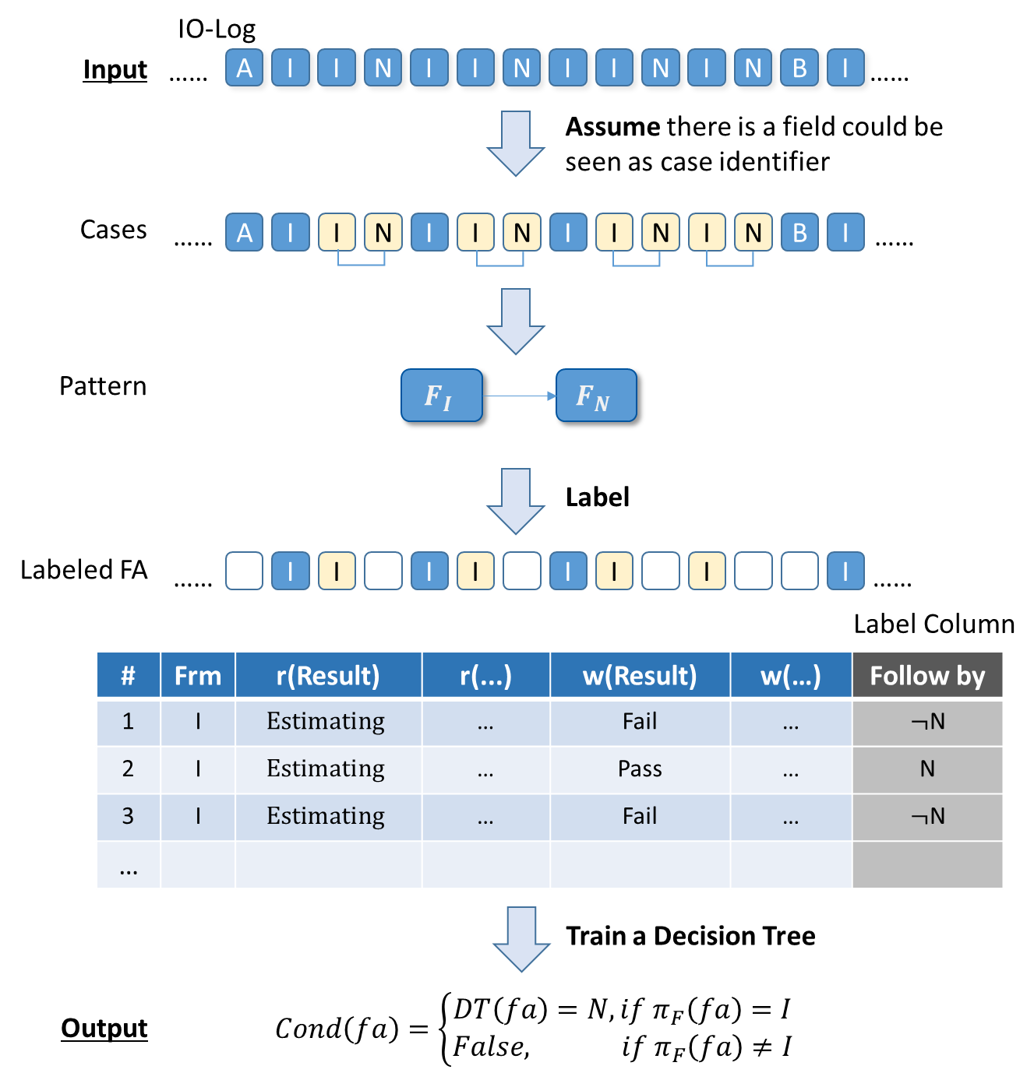
Training-Learn Rule
Training
Condition
I is for interviewee form
N is for new employee form
Other is noise

Slide 18
Training-Learn Rule
Training
Condition
I is for interviewee form
N is for new employee form
Other is noise

Slide 19
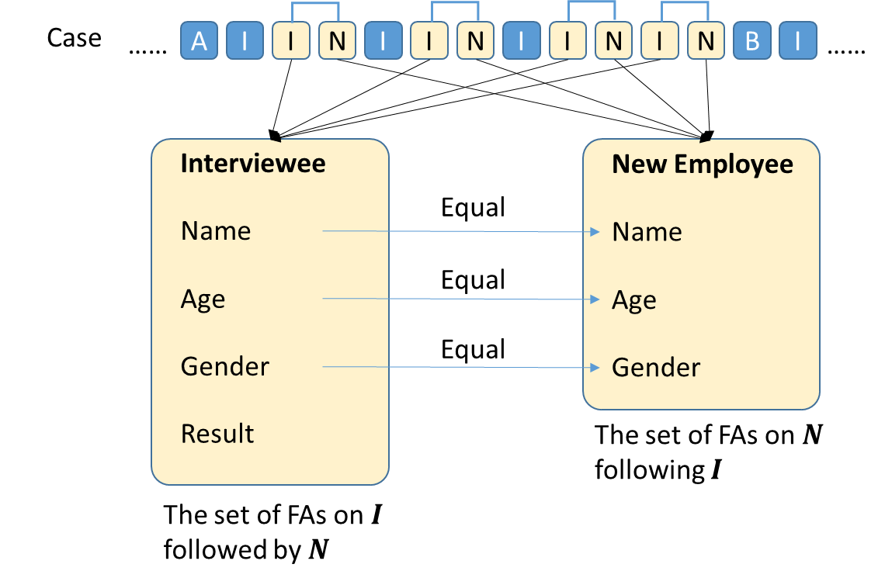
Training-Learn Rule
Training
Response
I is for interviewee form
N is for new employee form
Other is noise
Only focus on information transformation

Slide 20
Research Agenda
In Next 2 and half Years
E2E structure
What & How
Mining Condition Model(CM, Process Discovery)
(A kind of behavior pattern)
Mining with Case id
Mining without Case id
Complex Rule
What is Complex Rule(CR)
Learning Condition Function of CR (CM+ Causality)
Learning Response Function of CR (CM+ Data Mining)
Operating Problems
RE, multiply Rules’ conditions satisfied, select which one?
Detect Interface change and update Rules
Nearly Finished
Next Topic
To the end
2019
First half
2020
Second half
First half
2021
Second half

Slide 21
Condition Mining Model, Algorithm, and Experiment
Junxiong(Frank) Gao
21.5.2019

Slide 22
Bullet Points
Main Idea
Condition Model
Example
Experiment
process discovery in Streaming Log(No Case ID)
Synthesis Log
Streamed Repair Example
process discovery in Normal Event Log(Have Case ID)
Conclusion

Slide 23
Condition Mining
Main Idea-Goal
Input
From activities sequence
A
B
C
D
A
F
B
C
I
A
B
C
M
N
……
……
Detect
A
B
C
D
A
F
B
C
I
A
B
C
M
N
……
……
Output
Patterns between forms
A
SN
B
SN
C
Benefit
Reduce the Rule’s searching area

Slide 24
Condition Mining
Main Idea-Goal
Adopt at RPA research,
deduce the Rules’ Condition for Robot
Input
Activities sequence
A
B
C
D
A
F
B
C
I
A
B
C
M
N
……
IO-Log
……
Detect
A
B
C
D
A
F
B
C
I
A
B
C
M
N
……
Case
……
Output
Condition Relation between activities
A
SN
B
SN
C
Pattern

Slide 25
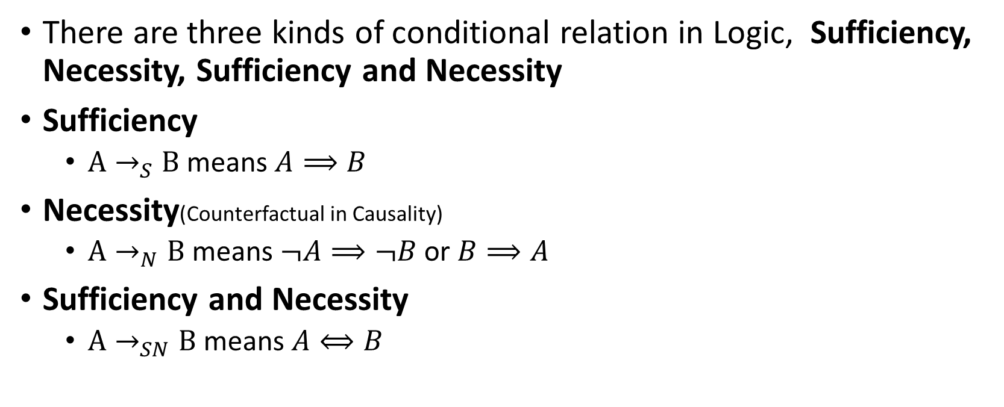
Main Idea
Theory
There are three kinds of conditional relation in Logic, Sufficiency, Necessity, Sufficiency and Necessity
Sufficiency
${A→}_{S}B$ means $A⟹B$
Necessity(Counterfactual in Causality)
${A→}_{N}B$ means $¬A⟹¬B$ or $B⟹A$
Sufficiency and Necessity
${A→}_{SN}B$ means $A⟺B$

Slide 26
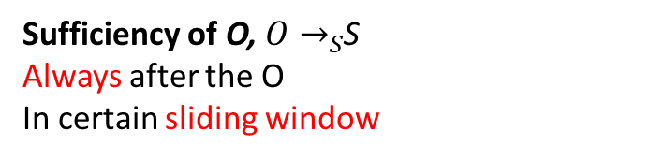
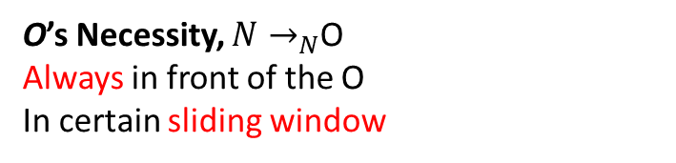
Main Idea
Adopt Theory
In a stream data
Sufficiency of O, ${O→}_{S}$S
Always after the O
In certain sliding window
……
N
N
N
O
S
S
S
……
O’s Necessity, ${N→}_{N}$O
Always in front of the O
In certain sliding window
“Always” is not “Could Be”

Slide 27
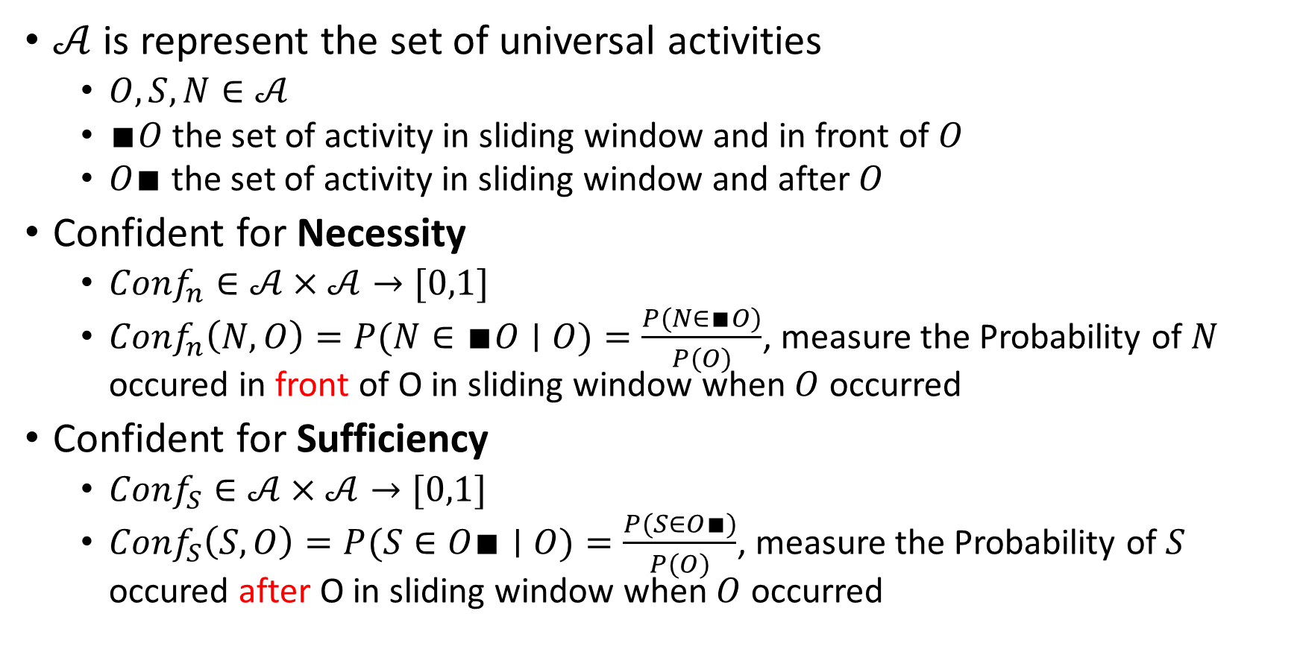
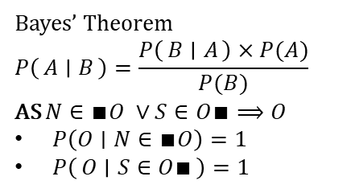
Main Idea
Measurement for the “Always”
$𝒜$ is represent the set of universal activities
$O,S,N∈𝒜$
$∎O$ the set of activity in sliding window and in front of $O$
$O∎$the set of activity in sliding window and after $O$
Confident for Necessity
$Conf_{n}∈𝒜×𝒜→[0,1]$
$Conf_{n}\left(N,O\right)=P(N∈∎O∣O)=\frac{P(N∈∎O)}{P(O)}$, measure the Probability of $N$ occured in front of O in sliding window when $O$ occurred
Confident for Sufficiency
$Conf_{S}∈𝒜×𝒜→[0,1]$
$Conf_{S}\left(S,O\right)=P(S∈O∎∣O)=\frac{P(S∈O∎)}{P(O)}$, measure the Probability of $S$ occured after O in sliding window when $O$ occurred
Bayes’ Theorem
$$P\left(A ∣ B\right)=\frac{P\left(B ∣ A\right)×P(A)}{P(B)}$$
AS $N∈∎O ∨S∈O∎⟹O$
$P\left(O∣N∈∎O\right)=1$
$P\left(O ∣ S∈O∎\right)=1$

Slide 28
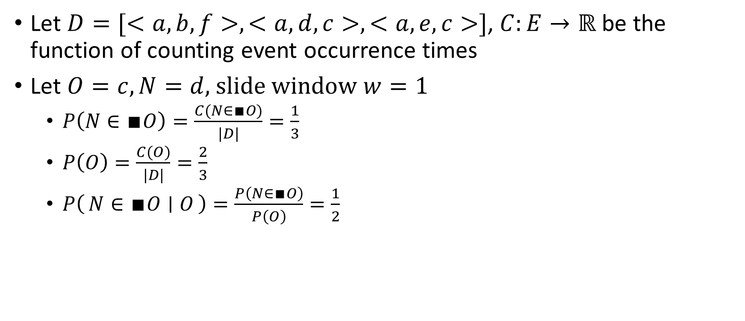
Main Idea
More explanation more the formulas
Let $D=[<a,b,f>, <a,d,c>,<a,e,c>]$, $C:E→ℝ$ be the function of counting event occurrence times
Let $O=c, N=d,$slide window $w=1$
$P\left(N∈∎O\right)=\frac{C(N∈∎O)}{|D|}=\frac{1}{3}$
$P\left(O\right)=\frac{C(O)}{|D|}=\frac{2}{3}$
$P\left(N∈∎O ∣ O\right)=\frac{P\left(N∈∎O\right)}{P\left(O\right)}=\frac{1}{2}$

Slide 29
Bullet Points
Main Idea
Condition Model
Example
Experiment
process discovery in Streaming Log(No Case ID)
Synthesis Log
Streamed Repair Example
process discovery in Normal Event Log(Have Case ID)
Conclusion

Slide 30
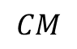
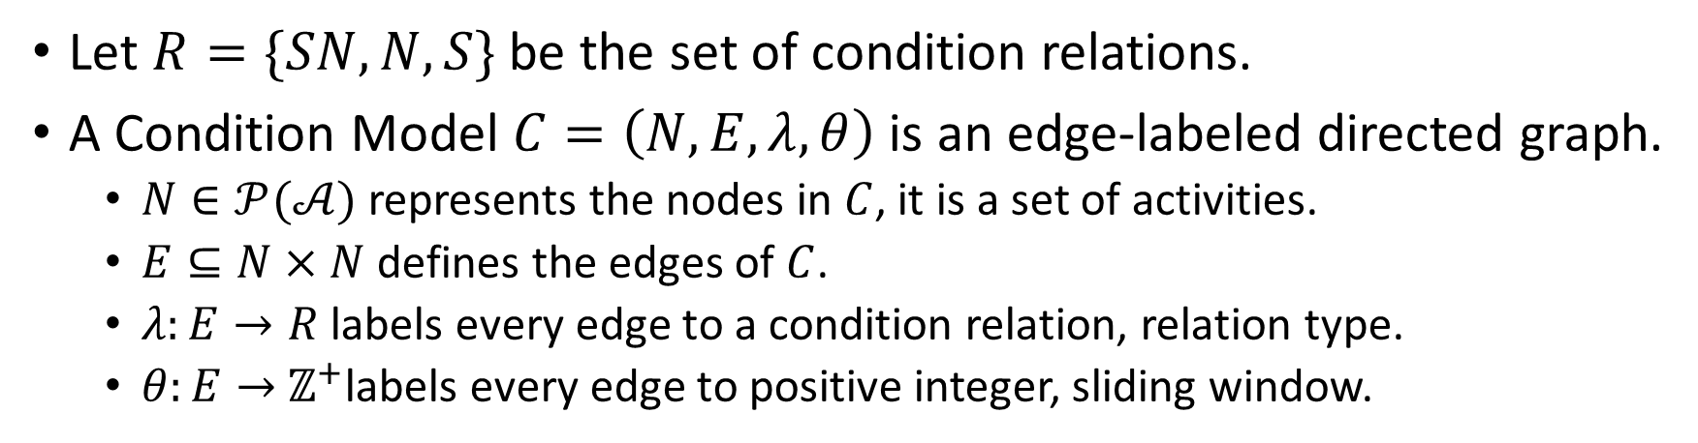
Condition Model
Definition
Let $R=\{SN,N,S\}$ be the set of condition relations.
A Condition Model $C=\left(N,E, λ,θ\right)$ is an edge-labeled directed graph.
$N∈𝒫(𝒜)$ represents the nodes in $C$, it is a set of activities.
$E⊆N×N$ defines the edges of $C$.
$λ:E→R$ labels every edge to a condition relation, relation type.
$θ:E→$ $ℤ^{+}$labels every edge to positive integer, sliding window.
Example
Let $A,B,C∈𝒜$ be three activities
B
(N,3)
C
$$CM$$
(SN,3)
A

Slide 31
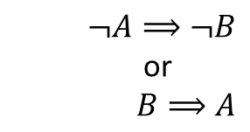
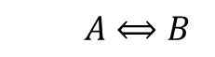
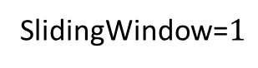
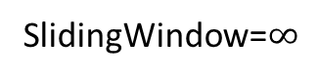
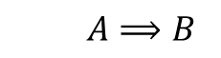
Condition Model
Interpret of Relations
Condition
Declare
Petri Net
Similar with
SlidingWindow=$∞$
SlidingWindow=$1$
A
SN
B
$$A⟺B$$
A
B
A
B
in SlidingWindow
A
S
B
A
$$A⟹B$$
A
B
in SlidingWindow
B
A’
$¬A⟹¬B$
or
$B⟹A$
B
B’
A
N
A
B
A
B
in SlidingWindow

Slide 32
Condition Model
Interpret the Relations’ combinations
Condition Model
Petri Net
Similar with
B
SN
C
B
And-join
C
SN
A
A
And-split
B
SN
B
C
C
SN
A
A
Strong Relation, like control-flow

Slide 33
Condition Model
Interpret the Relations’ combinations
Condition Model
Petri Net
C’
Similar with
B
N
C
B
And-join
C
N
A
A
C’’
B
C’
S
B
C
C
And-split
S
A
A
C’’
weak Relation, like declare

Slide 34
Condition Model
Interpret the Relations’ combinations
Condition Model
Petri Net
Similar with
B
S
C
B
Not And-join
C
A
S
A
…
B
N
B
C
C
Not And-split
N
A
A
weak Relation, like declare

Slide 35
Condition Model
Actions on Condition Model
Update
Using data to revise the relation
Query
Searching relation between two activities
Searching all related activates for one activity
Deduce
Using data to find causality candidate between two activities
Query
B
E
F
N
N
SN
C
S
N
D
A

Slide 36
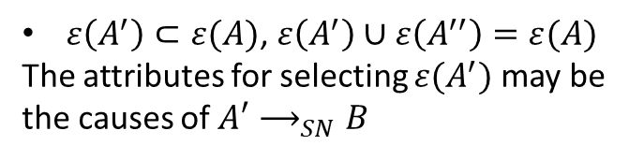
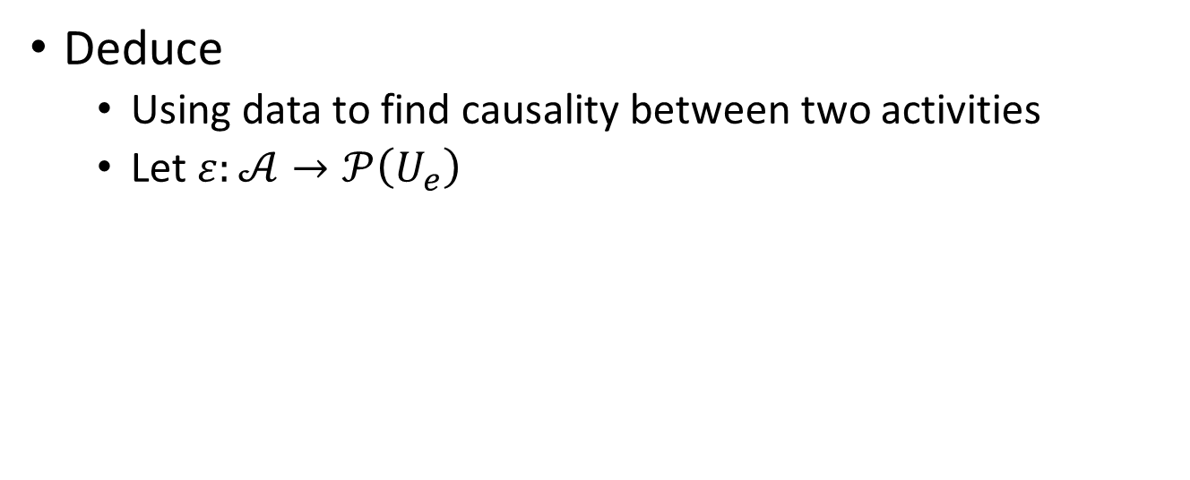
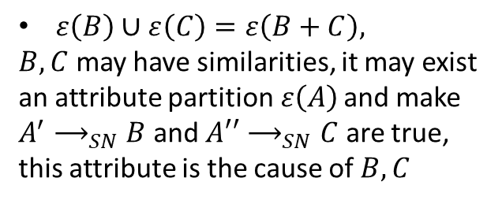
Condition Model
Actions on Condition Model
Rule Candidate in RPA
Deduce
Using data to find causality between two activities
Let $ε:𝒜→𝒫\left(U_{e}\right)$
SN is the Causality Candidate
A
A’
Split
N
SN
$ε\left(A^{′}\right)⊂ε(A)$, $ε\left(A^{′}\right)∪ε\left(A^{′′}\right)=ε(A)$
The attributes for selecting ${ε(A}^{′})$ may be the causes of $A′⟶_{SN}B$
B
A’’
B
N
C
A
$ε\left(B\right)∪ε\left(C\right)=ε\left(B+C\right),$
$B,C$ may have similarities, it may exist an attribute partition$ε\left(A\right)$ and make $A^{′}⟶_{SN}B$ and $A′′⟶_{SN}C$ are true, this attribute is the cause of $B,C$
Joint
A
SN
B
B+C
N

Slide 37
Condition Mining
Different between Condition Model with imperative language
Imperative language
Descripts running sequence-“Should do”
Tokens are consumed and produced
Declare language
Descripts running boundary-“Could do”
Condition Model
Descripts running conditions, it is the hybrid of Imperative and declare.
“Could do” + “Should do”
Satisfied condition has validity period, it likes traffic light in cross.
CM could be the halfway for learning Causality(Root Cause).

Slide 38
Bullet Points
Main Idea
Condition Model
Example
Experiment
process discovery in Streaming Log(No Case ID)
Synthesis Log
Streamed Repair Example
process discovery in Normal Event Log(Have Case ID)
Conclusion

Slide 39
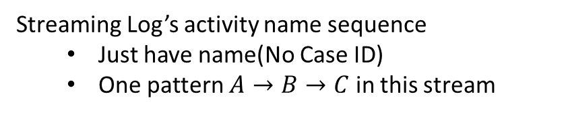
Example
A
B
C
D
A
F
B
C
I
A
B
C
M
N
……
……
Streaming Log’s activity name sequence
Just have name(No Case ID)
One pattern $A→B→C$ in this stream

Slide 40
Example
A
B
C
D
A
F
B
C
I
A
B
C
M
N
……
……
N
S
sliding window=2
Necessary and Sufficient Table$∈ℬ\left(𝒜×𝒫\left(𝒜\right)×𝒫\left(𝒜\right)\right)$
N
S
[<C, {A,B},{D,A}>]

Slide 41
Example
A
B
C
D
A
F
B
C
I
A
B
C
M
N
……
……
N
S
Necessary and Sufficient Table
N
S
[<C, {A,B},{D,A}>,
<D, {B,C},{F,A}>]

Slide 42
Example
A
B
C
D
A
F
B
C
I
A
B
C
M
N
……
……
N
S
Necessary and Sufficient Table
N
S
[<C, {A,B},{D,A}>,
<D, {B,C},{F,A}>,
<A, {D,C},{F,B}>]

Slide 43
Example
A
B
C
D
A
F
B
C
I
A
B
C
M
N
……
……
N
S
Necessary and Sufficient Table
N
S
[<C, {A,B},{D,A}>,
<D, {B,C},{F,A}>,
<A, {D,C},{F,B}>,
<F, {D,A},{C,B}>]

Slide 44
Example
A
B
C
D
A
F
B
C
I
A
B
C
M
N
……
……
N
S
Necessary and Sufficient Table
N
S
[<C, {A,B},{D,A}>,
<D, {B,C},{F,A}>,
<A, {D,C},{F,B}>,
<F, {D,A},{C,B}>,
<B, {F,A},{C,I}>]

Slide 45
Example
A
B
C
D
A
F
B
C
I
A
B
C
M
N
……
……
N
S
Necessary and Sufficient Table
N
S
[<C, {A,B},{D,A}>,
<D, {B,C},{F,A}>,
<A, {D,C},{F,B}>,
<F, {D,A},{C,B}>,
<B, {F,A},{C,I}>,
<C, {F,B},{I,A}>]

Slide 46
Example
A
B
C
D
A
F
B
C
I
A
B
C
M
N
……
……
N
S
Necessary and Sufficient Table
N
S
[<C, {A,B},{D,A}>,
<D, {B,C},{F,A}>,
<A, {D,C},{F,B}>,
<F, {D,A},{C,B}>,
<B, {F,A},{C,I}>,
<C, {F,B},{I,A}>,
<I, {B,C},{B,A}>]

Slide 47
Example
A
B
C
D
A
F
B
C
I
A
B
C
M
N
……
……
N
S
Necessary and Sufficient Table
N
S
[<C, {A,B},{D,A}>,
<D, {B,C},{F,A}>,
<A, {D,C},{F,B}>,
<F, {D,A},{C,B}>,
<B, {F,A},{C,I}>,
<C, {F,B},{I,A}>,
<I, {B,C},{B,A}>,
<A, {I,C},{B,C}>]

Slide 48
Example
A
B
C
D
A
F
B
C
I
A
B
C
M
N
……
……
N
S
Necessary and Sufficient Table
N
S
[<C, {A,B},{D,A}>,
<D, {B,C},{F,A}>,
<A, {D,C},{F,B}>,
<F, {D,A},{C,B}>,
<B, {F,A},{C,I}>,
<C, {F,B},{I,A}>,
<I, {B,C},{B,A}>,
<A, {I,C},{B,C}>,
<B, {I,A},{M,C}>]

Slide 49
Example
A
B
C
D
A
F
B
C
I
A
B
C
M
N
……
……
N
S
Necessary and Sufficient Table
N
S
[<C, {A,B},{D,A}>,
<D, {B,C},{F,A}>,
<A, {D,C},{F,B}>,
<F, {D,A},{C,B}>,
<B, {F,A},{C,I}>,
<C, {F,B},{I,A}>,
<I, {B,C},{B,A}>,
<A, {I,C},{B,C}>,
<B, {I,A},{M,C}>, <C, {A,B},{M,N}>]

Slide 50
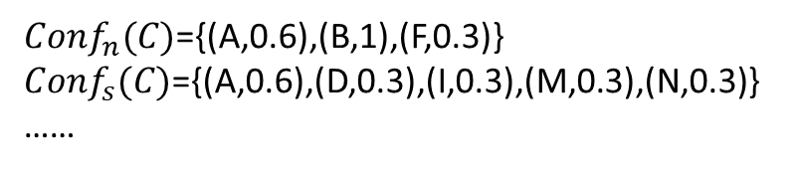
Example
A
B
C
D
A
F
B
C
I
A
B
C
M
N
……
……
N
S
Necessary and Sufficient Table
N
S
Relation’s Confident
[<C, {A,B},{D,A}>,
<D, {B,C},{F,A}>,
<A, {D,C},{F,B}>,
<F, {D,A},{C,B}>,
<B, {F,A},{C,I}>,
<C, {F,B},{I,A}>,
<I, {B,C},{B,A}>,
<A, {I,C},{B,C}>,
<B, {I,A},{M,C}>, <C, {A,B},{M,N}>]
C. occur =3
C. Necessary ={(A,2),(B,3),(F,1)}
C. Sufficient ={(A,2),(D,1),(I,1),(M,1),(N,1)}
……
$Conf_{n}(C)$={(A,0.6),(B,1),(F,0.3)}
$Conf_{s}(C)$={(A,0.6),(D,0.3),(I,0.3),(M,0.3),(N,0.3)}
……

Slide 51
Example
A
B
C
D
A
F
B
C
I
A
B
C
M
N
……
……
N
S
Necessary and Sufficient Table
N
S
Relation’s Confident
SN Model
[<C, {A,B},{D,A}>,
<D, {B,C},{F,A}>,
<A, {D,C},{F,B}>,
<F, {D,A},{C,B}>,
<B, {F,A},{C,I}>,
<C, {F,B},{I,A}>,
<I, {B,C},{B,A}>,
<A, {I,C},{B,C}>,
<B, {I,A},{M,C}>, <C, {A,B},{M,N}>]
C. occur =3
C. Necessary ={(A,2),(B,3),(F,1)}
C. Sufficient ={(A,2),(D,1),(I,1),(M,1),(N,1)}
……
“Always” means very high threshold
A
Threshold = 0.9
SN
B
$Conf_{n}(C)$={(A,0.6),(B,1),(F,0.3)}
$Conf_{s}(C)$={(A,0.6),(D,0.3),(I,0.3),(M,0.3),(N,0.3)}
……
SN
C

Slide 52
Bullet Points
Main Idea
Condition Model
Example
Experiment
process discovery in Streaming Log
Synthesis Log
Streamed Repair Example
process discovery in Normal Event Log(Have Case ID)
Conclusion

Slide 53
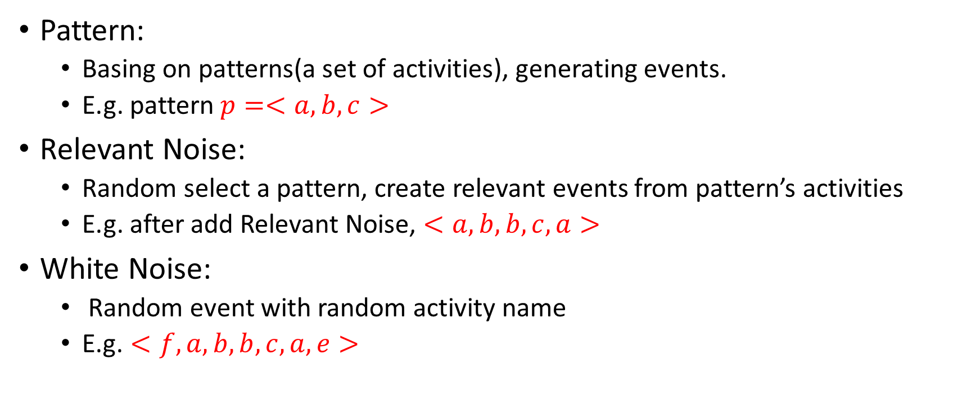
Condition Mining
Synthesis Log
Pattern:
Basing on patterns(a set of activities), generating events.
E.g. pattern $p=<a,b,c>$
Relevant Noise:
Random select a pattern, create relevant events from pattern’s activities
E.g. after add Relevant Noise, $<a,b,b,c,a>$
White Noise:
Random event with random activity name
$\text{E}\text{.}\text{g}\text{.}<f,a,b,b,c,a,e>$

Slide 54
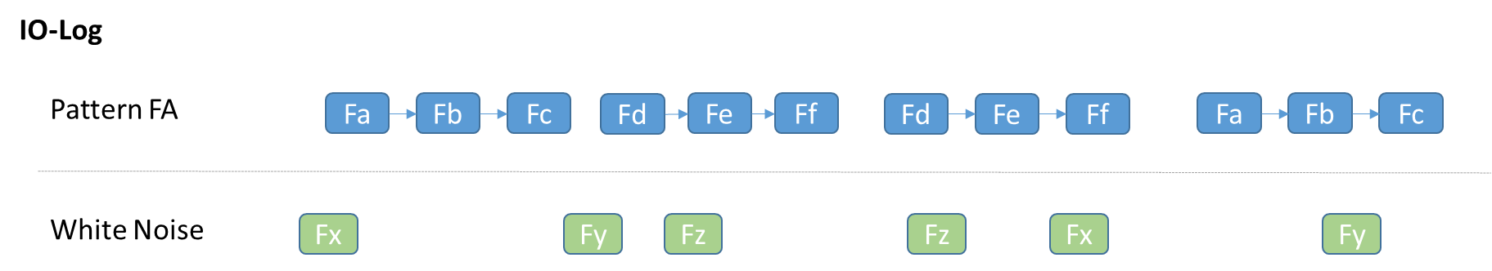
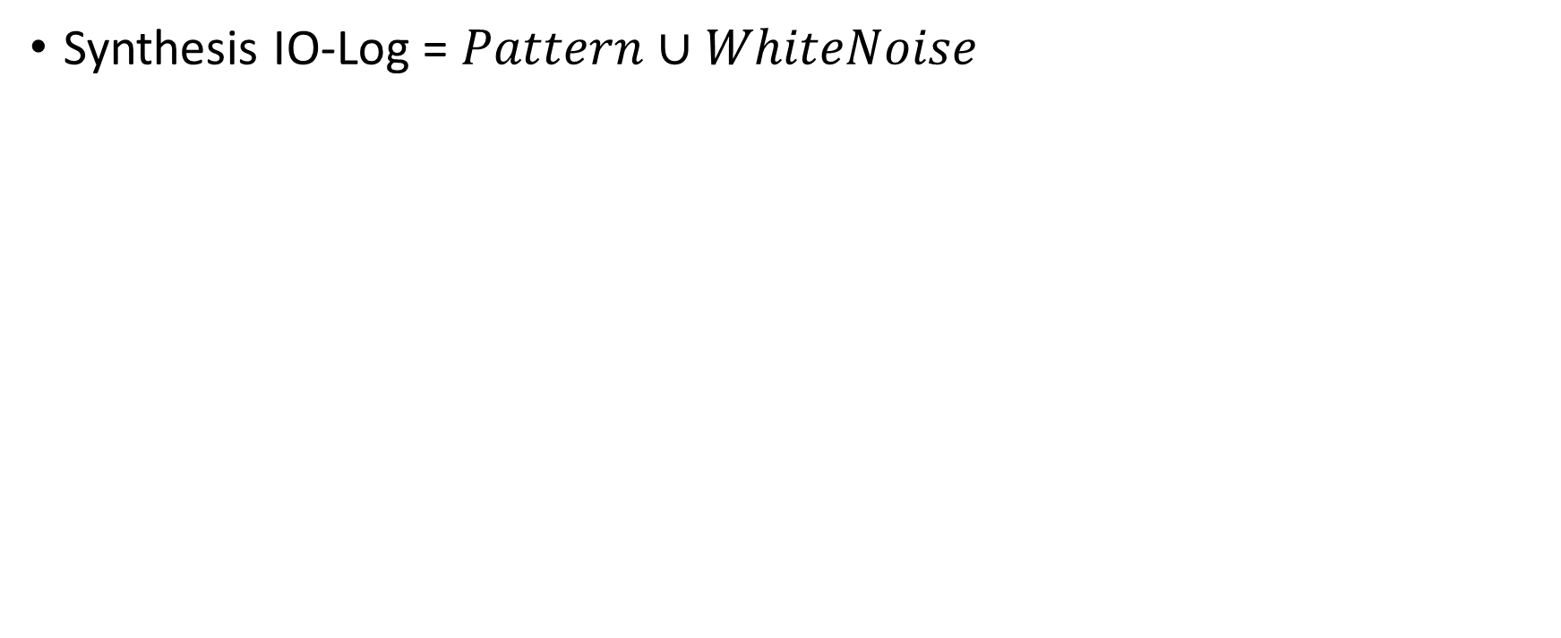
Condition Mining
Synthesis Log
Synthesis IO-Log = $Pattern∪WhiteNoise$
Just showing the idea, data has more noise

Slide 55
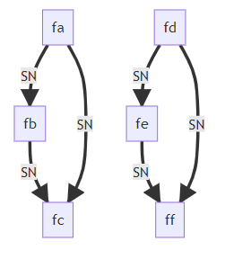
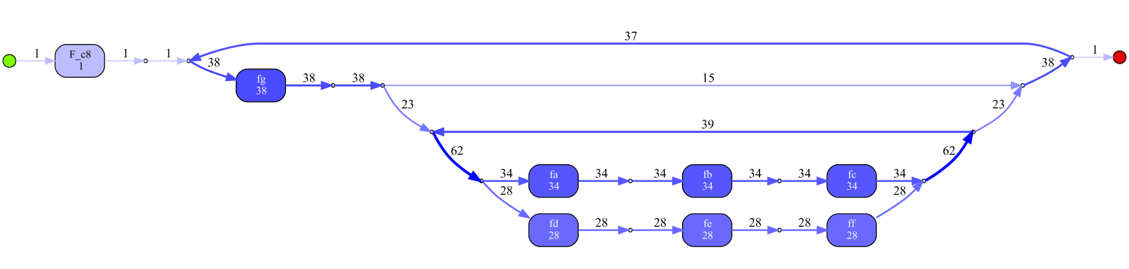
Condition Mining
Synthesis Log
Result for no relevant noise
Condition Miner
Inductive Visual Miner
Sliding window=5
Conf Threshold = 0.9
Has redundant

Slide 56
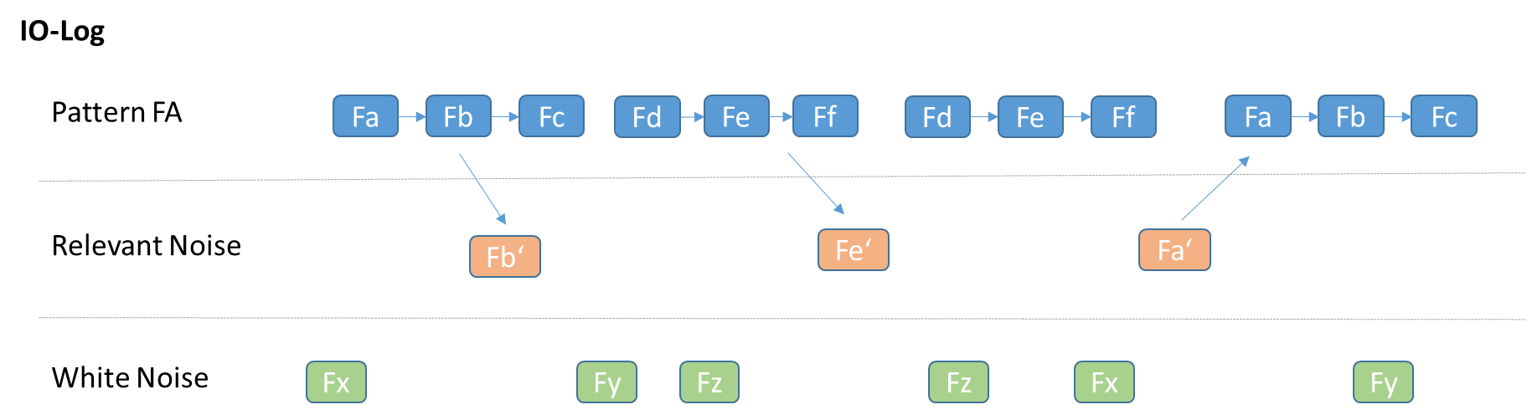
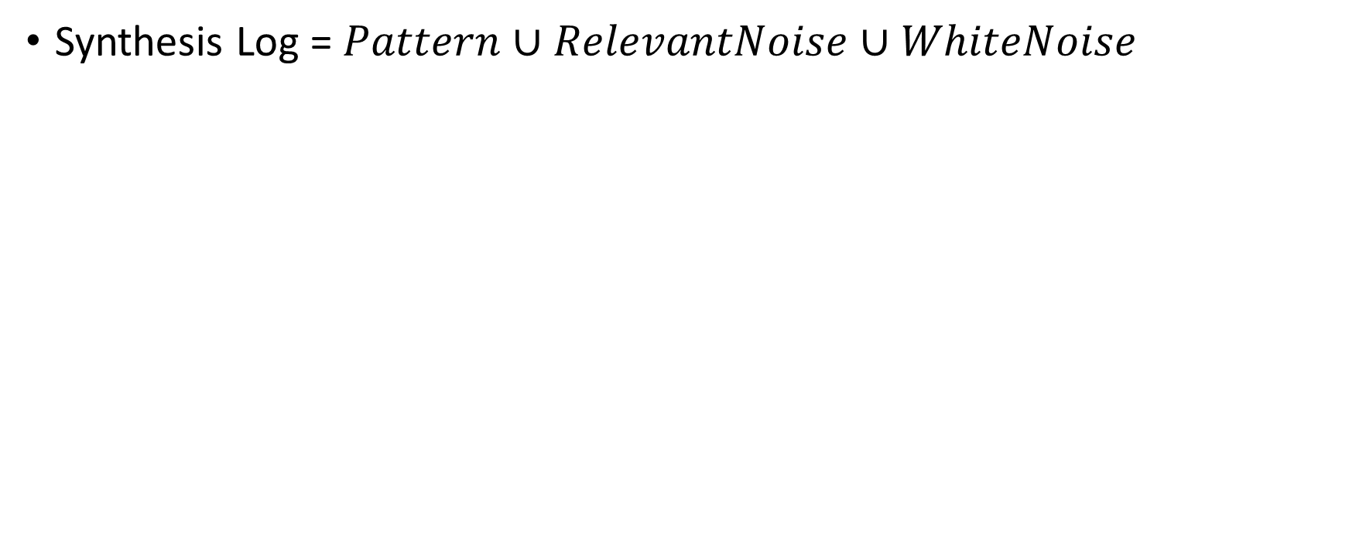
Condition Mining
Synthesis Log
Synthesis Log = $Pattern∪RelevantNoise∪WhiteNoise$
Just showing the idea, data has more noise

Slide 57

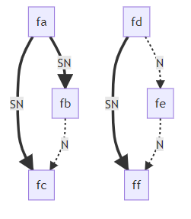
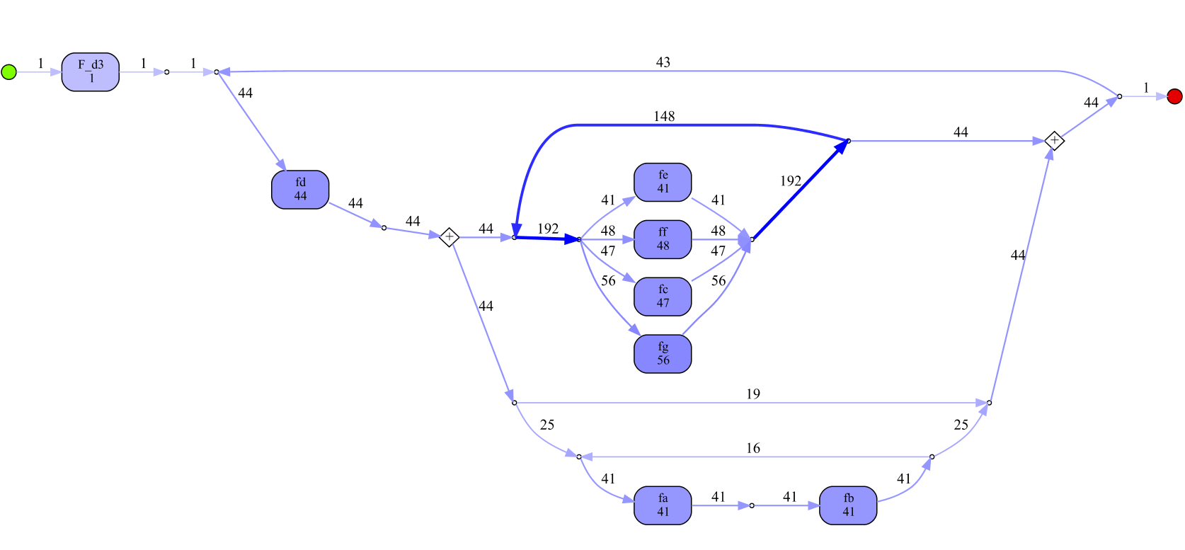
Condition Mining
Synthesis Log
Result for having relevant noise
Condition Miner
Inductive Visual Miner
Sliding window=5
Conf Threshold = 0.9

Slide 58
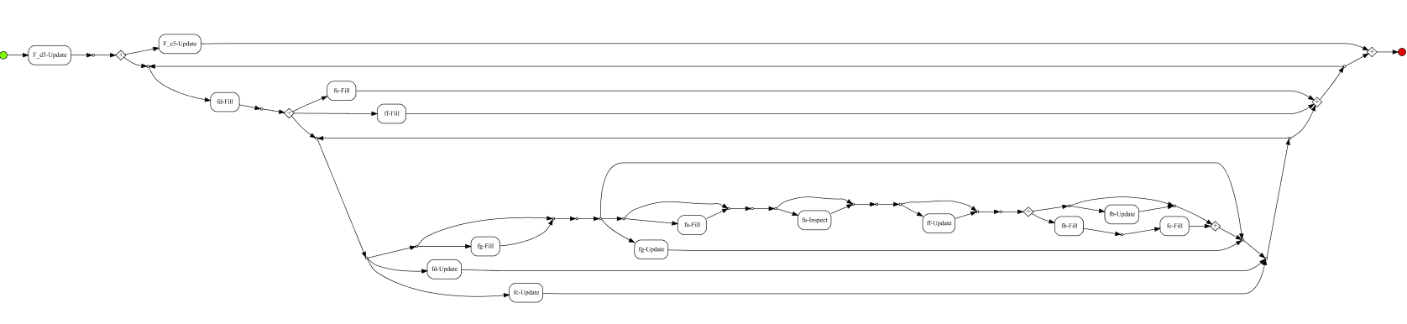
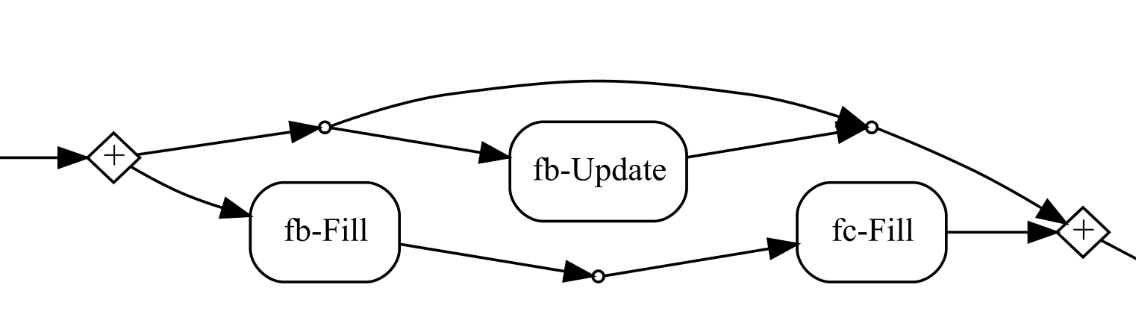
Condition Mining
Synthesis IO-Log
Result for having relevant noise
Inductive Visual Miner
Form behavior

Slide 59

Condition Mining
Synthesis Log
Result for having relevant noise
Condition Miner
Form behavior
Sliding window=5
Conf Threshold = 0.9

Slide 60
Bullet Points
Main Idea
Condition Model
Example
Experiment
process discovery in Streaming Log(No Case ID)
Synthesis Log
Streamed Repair Example
process discovery in Normal Event Log(Have Case ID)
Conclusion

Slide 61

Condition Mining
repairExample
Original Log
Discovered by Inductive Miner
Then, Put every event into one single trace

Slide 62

Condition Mining
repairExample
One single trace
Discovered by Inductive Visual Miner

Slide 63

Condition Mining
repairExample
One single trace
Discovered by Condition Miner
Sliding window=5
Threshold = 0.9
Original Log
Discovered by Inductive Miner

Slide 64
Bullet Points
Main Idea
Condition Model
Example
Experiment
process discovery in Streaming Log(No Case ID)
Synthesis Log
Streamed Repair Example
process discovery in Normal Event Log(Have Case ID)
Conclusion

Slide 65

Condition Mining
More Ingredient for normal process discovery
Loop
B,C is B Condition
Sliding window $→$ Eventually follow relation
Dealing with loop $→$ Relabel the repeat activity
Model complexity
Low frequency variants, not trustable trace $→$ filter variants by frequency(with really low threshold).
Unnecessary long term dependency
$→$Remove redundant relation, then
$→$ Use direct follow relation as filter(with really low threshold)
A
B
C
B
C
D
A is B Condition
(Filter noise)
(Gain Control-flow)
C
B
C
B
remove redundant
A
A

Slide 66


Condition Mining
Discovered by Inductive visual Miner
More Ingredient for normal process discovery
RepairExample
Sliding window= Eventually
Conf_Threshold = 0.9
DFG_Threshold = 0.05
Time consume = 0.1s

Slide 67


Condition Mining
More Ingredient for normal process discovery
Declare Maps Miner
RepairExample
Setting:
[{response, precedence},{all, min_support:90,0},
{Control-flow},{event types: complete}]
[{Select all},{all, min_support:90,0},
{Control-flow},{event types: complete}]
Sliding window= Eventually
Conf_Threshold = 0.9
DFG_Threshold = 0.05
Time consume = 0.1s

Slide 68

Condition Mining
More Ingredient for normal process discovery
Road Traffic Fine
Sliding window= Eventually
Conf_Threshold = 0.9
DFG_Threshold = 0.05
Time consume = 16s

Slide 69

Condition Mining
More Ingredient for normal process discovery
BPI challenge 2017 offer
Sliding window= Eventually
Conf_Threshold = 0. 9
DFG_Threshold = 0.05
Low Frequency Variants Threshold=0.01
Time consume = 1.1s

Slide 70

Condition Mining
More Ingredient for normal process discovery
BPI challenge 2018
Sliding window= Eventually
Conf_Threshold = 0.9
DFG_Threshold = 0.05
Time consume = 29s

Slide 71

Condition Mining
More Ingredient for normal process discovery
BPI challenge 2019
Sliding window= Eventually
Conf_Threshold = 0.9
DFG_Threshold = 0.05
Time consume = 12.2s

Slide 72
Bullet Points
Main Idea
Condition Model
Example
Experiment
process discovery in Streaming Log
Synthesis Log
Streamed Repair Example
process discovery in Normal Event Log
Conclusion

Slide 73

Conclusion
Advantage
Algorithm is simple and understandable (3 days work in Pm4py)
Query Conditional Relation for activities
Deduce Casualties between activities (Root Cause)
Explainable result
Fast
Need advises about
How to do the evaluation
Disadvantage
Difficulty in loop
Further Research
Hybrid of “with” and “without” case id situations

Slide 75
Condition Mining
Different between SN mode with other process modeling language
SN model
Descripts conditions
Satisfied condition has validity period, it likes light on in the sliding window, light off after the sliding window.
Only showing determinate relation, “Always”
In the middle of Petri Net and Declare Model, basing on SN relation could discovery Declare Model
Other modeling language
Descripts running sequence
Petri Net’s transition consume and produce tokens
Could show “Always” and “Could be” relation

